Slide 1

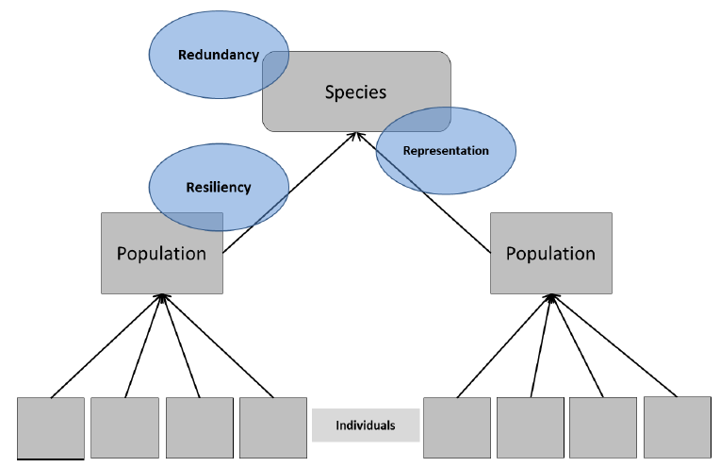
Species’ Needs
SPECIES
Notes:
At the Species level, we explore what influences redundancy and representation. We use the evolutionary history and historical distribution of the species as a starting point to understand how the species functions (or functioned) to maintain populations across its range.

Slide 2
The 3 R’s: how do populations contribute to species viability through resilience, redundancy and representation?
Species’ Viability
Redundancy
Population 4 Resilience
Population 1 Resilience
Population 2 Resilience
Population 3 Resilience
Representation
Notes:
The population resilience piece is very important to understand because it has a direct relationship to Species viability. Viable species need resilient populations. The resilience of each population unit contributes to “species viability”. Species viability and what drives viability up or down is ultimately what we care about in the SSA.
How many populations, where they occur, how resilient they are, how diverse they are, and how they interact with each other is our characterization of viability using the 3Rs.
Resilience is the likelihood that a population will be sustained in the wild at a ‘healthy’ level over time; the ability of the species to withstand the normal environmental variation and periodic disturbance; having the ability to recover from “bad years” and periodic “bad events” (tornadoes, floods, storms).
Resiliency describes the ability of the species to withstand stochastic disturbance events, which is associated with population size, growth rate, and habitat quality.
Representation is the conservation of species within areas of significant geographic, genetic, or life history variation.
Representation describes the ability of a species to adapt to changing environmental conditions, which is related to distribution within the species’ ecological settings.
Redundancy is the probability distribution for the number of populations that will be sustained over time taking into account random disturbance, including large-scale catastrophic events.
It is the ability to sustain populations in the face of catastrophic events; represents the likelihood that all pops are exposed to catastrophic events concurrently.
Redundancy describes the ability of a species to withstand catastrophic events, which is related to the number, distribution, and resilience of populations.
Viablity is the likelihood that populations will be sustained within representative areas over time, which is a function of resilience and redundancy of populations within those representative areas. It is sustaining a sufficient number and distribution of healthy populations to withstand environmental stochasticity (resiliency), catastrophes (redundancy), and changes in environmental conditions (representation).
Viability is not a static state; a species can be less or more viable (degrees) or have low to high viability (continuum)
Go over to the posters on the wall, and discuss with the class metrics for each – maybe list them under the posters on a flip chart page?
Janice – put up pages and record lists
What do people look at for the 3Rs: discussion of this in the SSA Framework Guidance under Stage 1: Ecological Needs.
Then, ask the class: When you think of pop resiliency, what do you think of. Use the flip chart to take notes (Janice will take the notes). Then, when you think about representation, what do you think of? What about redundancy? Use the 3Rs poster on the wall to illustrate. Have a list available as hints to the speaker.

Slide 3
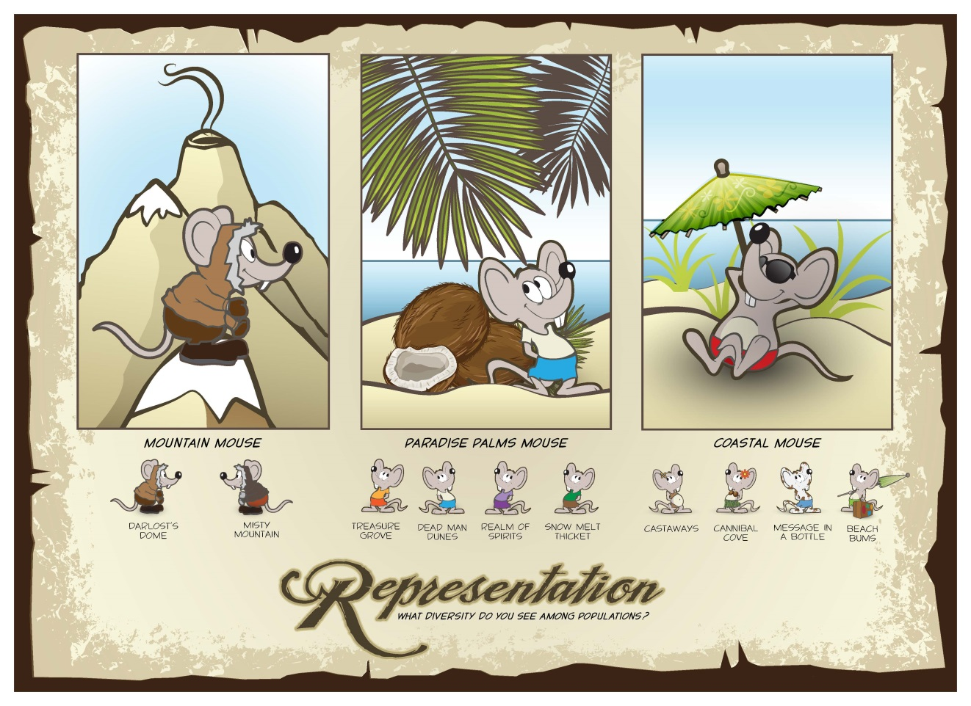
Species’ Needs
SPECIES
Ecological
Needs –
Species
Notes:
What is the ability of our species to adapt to changing environmental conditions over time? What are some examples of “changing environmental conditions”? List…some answers could be
-Increase in fire frequency
-Decrease in rainfall
-Increase in temperatures
-etc. (these are mainly stressors: a change word + an environmental quality or quantity)
Representation relates to the species’ ability to adapt to changing environmental conditions.
The breadth of genetic and environmental diversity within and among populations characterizes representation.
Representation is characterized by the breadth of genetic and environmental diversity within and among populations – is there enough genetic diversity to survive UNKNOWN ecological variation?
Measures may include the number of varied niches occupied, the genetic diversity, heterozygosity or alleles per locus.

Slide 4
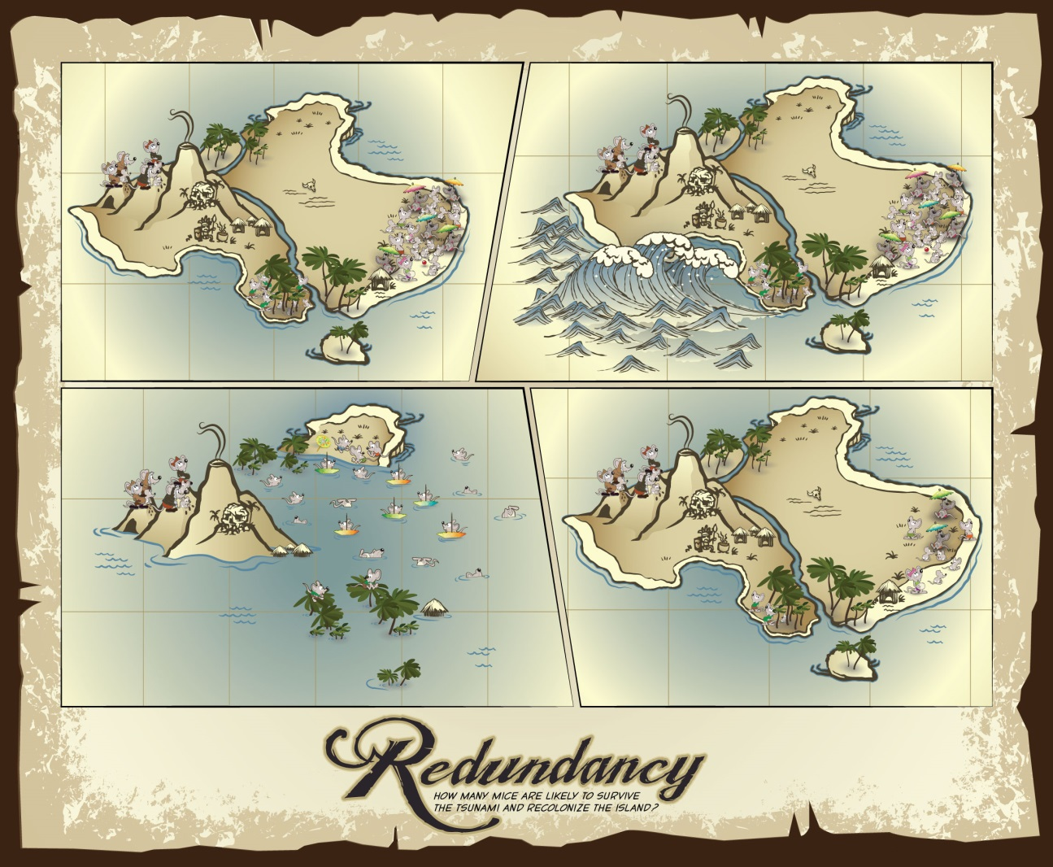
Species’ Needs
SPECIES
Ecological
Needs –
Species
(Insert Redundancy graphic here)
Notes:
Redundancy describes the ability of a species to withstand catastrophic events. It is about spreading risk among multiple populations to minimize the potential loss of the species from a catastrophic event.
Are there multiple, resilient populations distributed within the species’ ecological settings and across the species range?
Measures can be
-population number
-resilience
-spatial extent
-degree of connectivity
Tara’s handout – hand out to the class here?

Slide 5
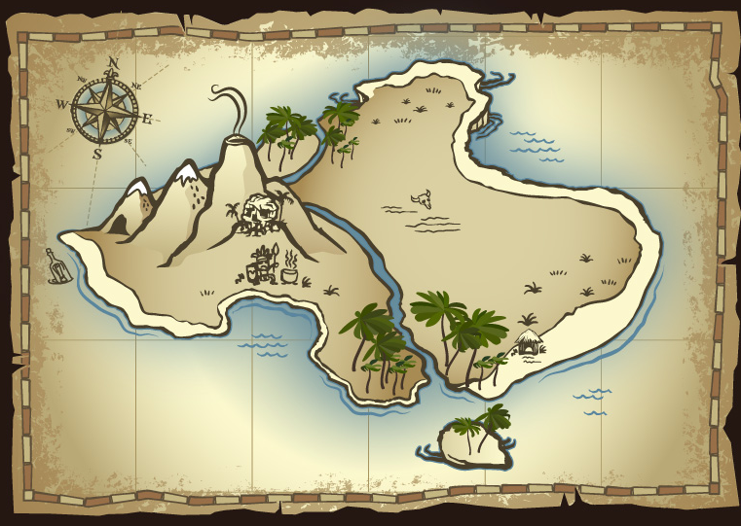
Species’ Needs
SPECIES
EXERCISE 4.
Species
Scale Needs
Notes:
For this exercise, they will NOT break out into their population groups. It is the end of the day, and we are combining our knowledge anyway!
Start by asking someone from each population to come up to the wall map and point to their population. Do it in order of Ecological Settings so you can also point out the 3 representative units. Ask everyone to complete their species map in their workbooks as this is done – include the historical range and all populations.
Next, discuss the three Ecological Settings – Coastal, Paradise Palms (Plains), Mountains. Ask the groups in each Ecological Setting to share details about their populations with the class (NOT BASELINE YET, but just enough to fill out the Table to discuss Representation).
Then go over the Redundancy and Representation questions in the workbook and ask for answers from the participants.

Slide 6
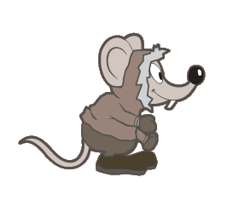
Species’ Needs
SPECIES
Taxonomy
Life history
Habitat
Ecological Needs at
Individual level
Population level
Species level
Notes:
Briefly Review Species Ecological Needs before adjourning for lunch.

Slide 7
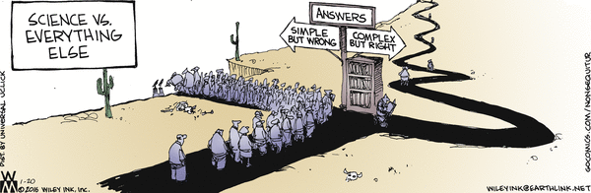
Species’ Needs
SPECIES
Notes:
Adjourn for lunch.

Slide 8

Current Condition
Please be back at 1:00!
Notes:
When we come back from lunch, we will begin to discuss CURRENT CONDITION!

